Slide 1
Assessment of Effective Damage Prevention
Kevin Hopper, Dig Safely New York
Notes:
Good afternoon, I’m Kevin Hopper, Operations Manager from Dig Safely New York.
Today I’m going to talk to you about Dig Safely New York’s damage prevention programs, and a couple of tools Dig Safely New York has implementing to assess how effective various programs are on reducing damages. I also going to discuss just how important of Stakeholder participation is in developing and improving a Damage prevention program.

Slide 2
What Works?
Notes:
What is working?
I think we all do a lot of things right to prevent damages but how do we know?
These are questions that need to be answered but how can we answer them?
Everyone in this room could have a different opinion about what is the best message and what is he best way to deliver it.

Slide 3

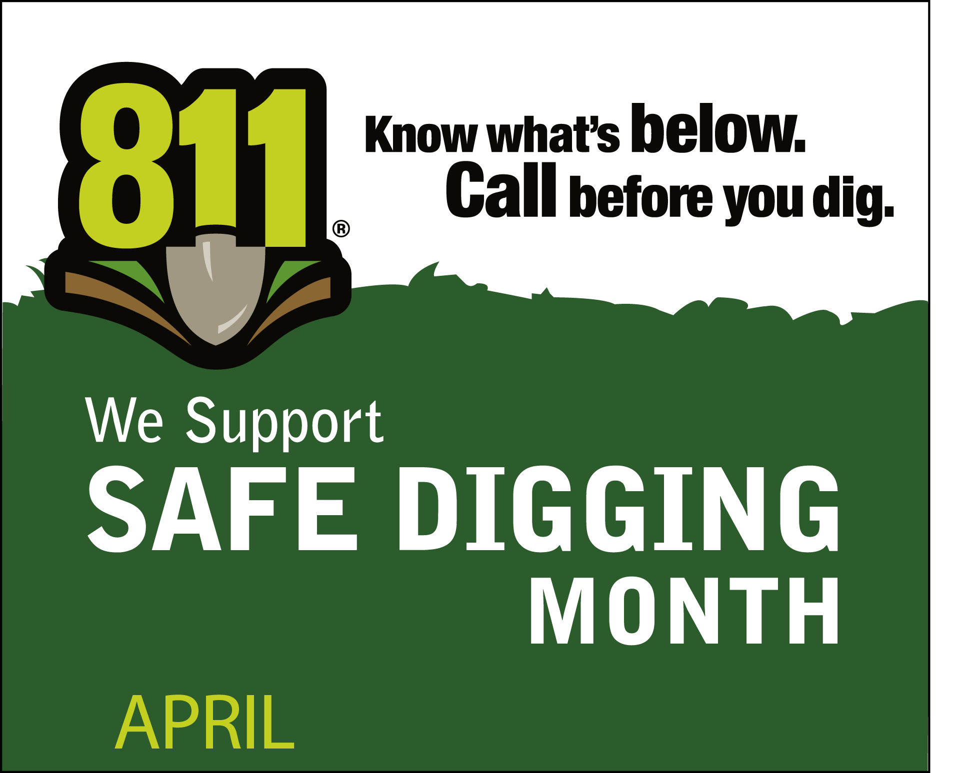
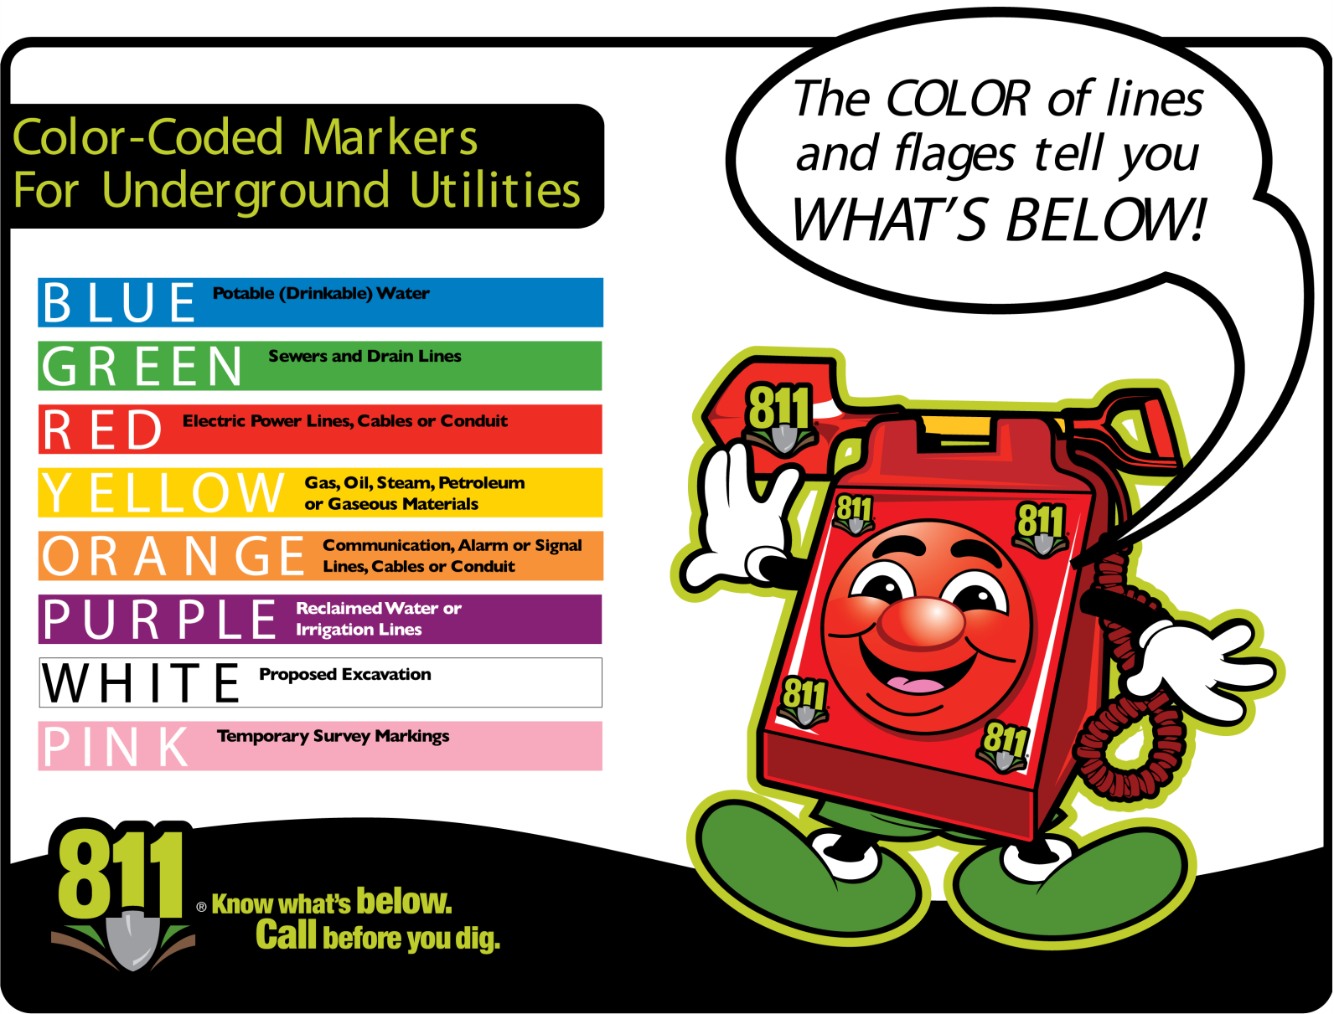
Reinforced the message
Notes:
We have seen the reinforcement approach to Damage Prevention, this approach can be seen through out the first 811 campaign.
***Add Pic, of more 811 national Ads.

Slide 4
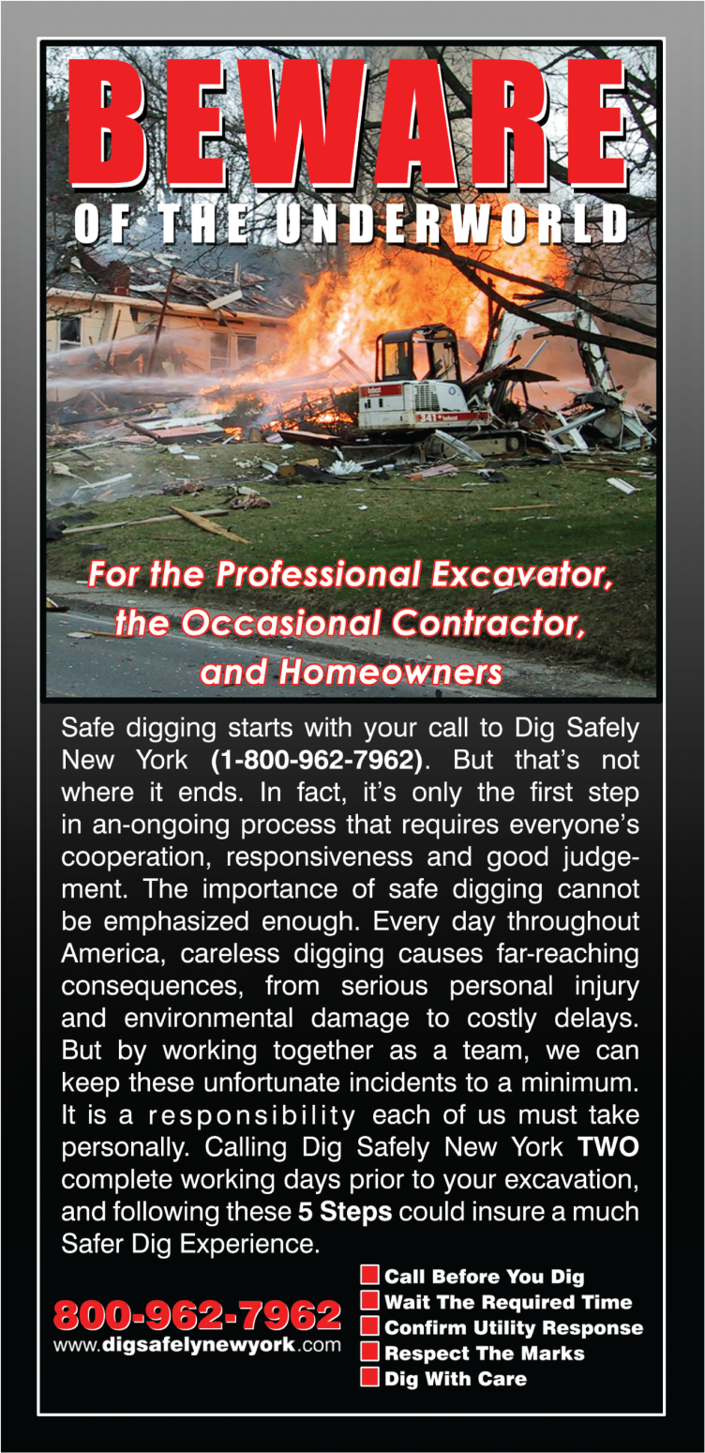
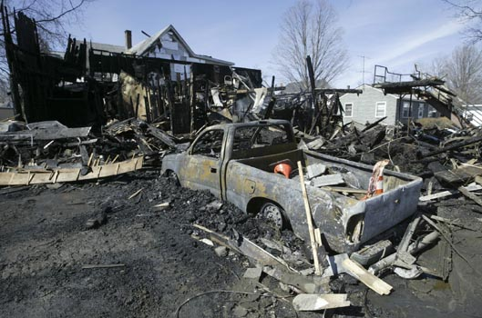
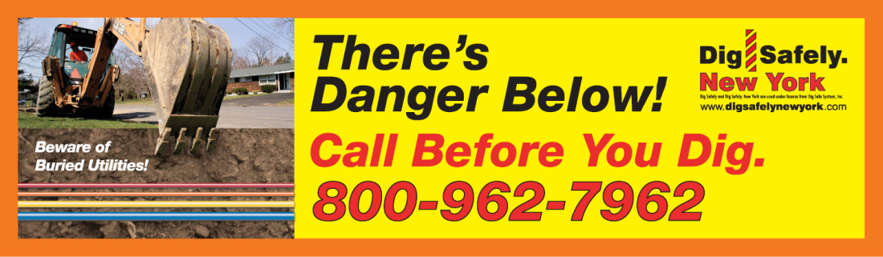
Demonstrated the consequences
Notes:
In NY we have utilized a more Shocking Approach in some of our advertising showing the audience the danger, the result on not digging safely.
Quick show of hands:
How many think the Beware message is more effective in promoting Damage Prevention?
In NY we were unable to really tell you. I have had an opinion and I had to base my assumption based on call volume and other limited statistical analysis that is available within the One Call Center.

Slide 5
PIPES ACT
Damage Prevention Program Elements
An effective damage prevention program includes nine elements:
Notes:
It is this lack of data that brings us to the pipes act, Within the Pipes act it defines the 9 elements of an effective damage prevention program
1. Participation by operators, excavators, and other stakeholders in the development and implementation of methods for establishing and maintaining effective communications between stakeholders from receipt of an excavation notification until successful completion of the excavation, as appropriate.
2. A process for fostering and ensuring the support and partnership of stakeholders,
3. A process for reviewing the adequacy of a pipeline operator’s internal performance measures regarding persons performing locating services and quality assurance programs.
4. Participation by operators, excavators, and other stakeholders in the development and implementation of effective employee training programs
5. A process for fostering and ensuring active participation by all stakeholders in public education for damage prevention activities.
6. A process for resolving disputes that defines the State authority’s role as a partner and facilitator to resolve issues.
7. Enforcement of State damage prevention laws and regulations for all aspects of the damage prevention process
8. A process for fostering and promoting the use, by all appropriate stakeholders, of improving technologies that may enhance communications, underground pipeline locating capability, and gathering and analyzing information about the accuracy and effectiveness of locating programs.
9. A process for review and analysis of the effectiveness of each program element, including a means for implementing improvements identified by such program reviews.

Slide 6
Element Nine
A process for review and analysis of the effectiveness of each program element, including a means for implementing improvements identified by such program reviews.
Notes:
And in NY it seemed the nine elements were in place for the large part; Until we got to Element 9. Looking at our Program the measurement of the effectiveness of each program was hard to verify in some cases. As a result of that assessment Dig Safely New York introduced two tools to assist in measuring the effectiveness. These 2 tools have provided significant upgrades in our ability to effectively measure and implement improvements to our damage prevention programs.

Slide 7
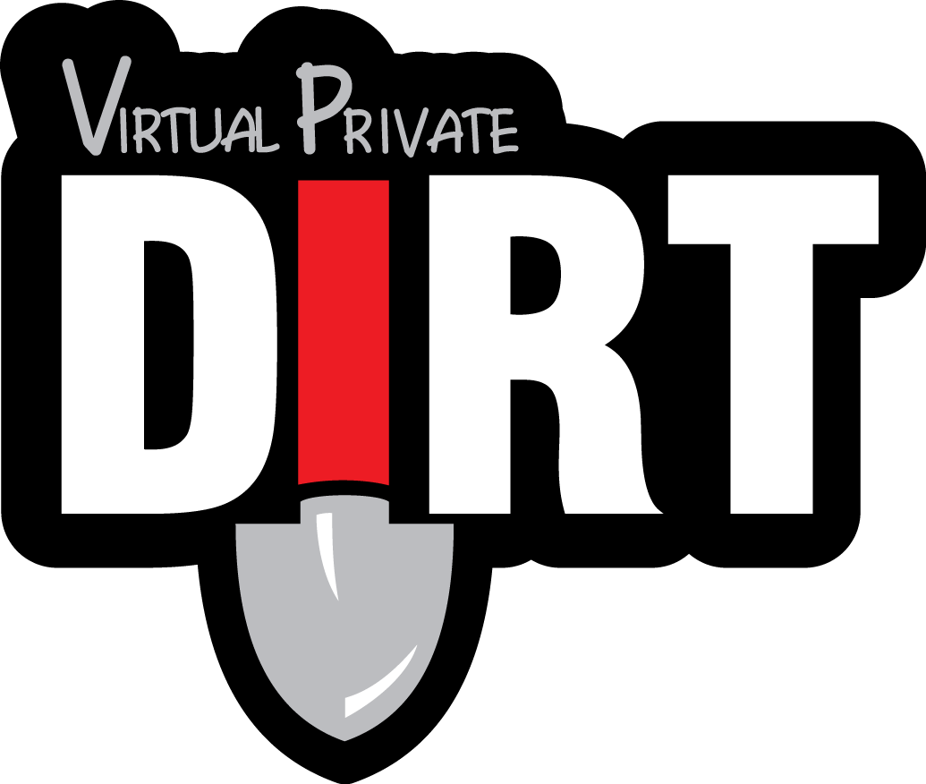
Virtual Private Dirt
Notes:
The first tool added was an instance of Virtual Private Dirt. This allowed for Dig Safely New York to assess what was happening within our footprint. The national Dirt Report is nice but for a specific State to base damage prevention effectiveness on a regional report is something that is not going to work. And To us the key measurement in an effective Damage Prevention Program is Damage Reduction. Virtual private dirt has provided as a mechanism to not only see damage data, but to react to it.
The key to Making Virtual Private Dirt work is having diverse Stakeholder participation. Submitters of damage Data need to share their data with you.

Slide 8
Damages/1000 Tickets
Notes:
We have seen damage reduction consistently across our footprint. Damages per 1000 tickets have been reduced every year since 2004. However when you strive for zero damages we needed better data to assist us and our membership in making the best use of our resources.
Given the economical situation we have faced over the past few years, throwing more money at damage prevention without a clear strategy and measurement of effectiveness was not an option especially with flat or reduced call volumes. This is where having your members understand the importance of sharing their damage information and the significance of that data in assisting the One call Center in developing a successful damage prevention program becomes essential. Reducing damages according to damage rates and being able to focus on areas of specific needs became quickly apparent the more data we were provided.

Slide 9
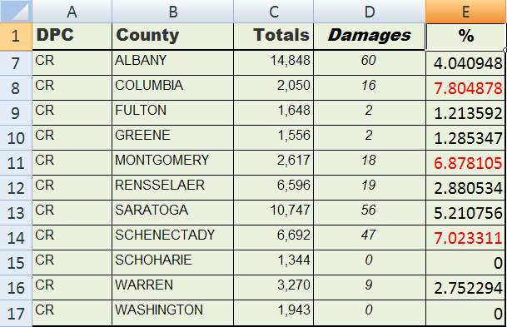
Notes:
In an assessment of the Virtual Private dirt data associated with call volume we were able to access the specific counties that needed damage prevention focus.

Slide 10
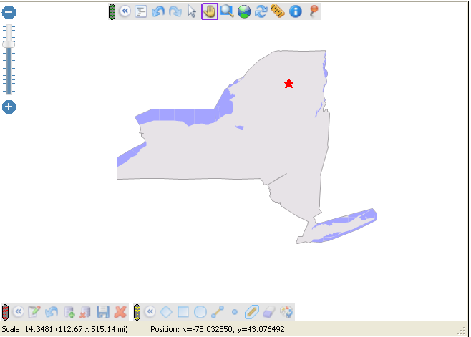
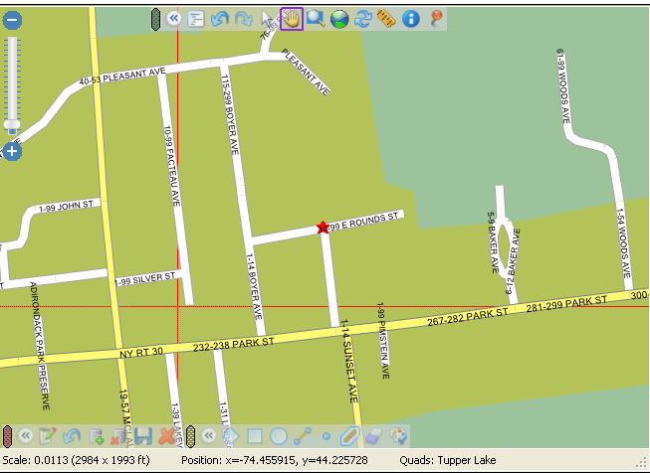
Taking the data further
Notes:
But we needed to taking that data further. Why was the ratio in one area lower than another. The solution to this was in introducing IrthNet Outreach. Outreach is a software solution that allows me to collect and report on our various Damage prevention activities.
You can plot your activities on the map and report based on activity type. For todays purpose I will be Focusing specifically on the number and locations of education programs held by our Field Reps. (Locations where we gave an hour safety presentation).
The results were quickly apparent. in areas where we were able to facilitate more training, damages were reduced. The Face to face training also showed the greatest effect in damage reduction as most of the excavation in the state takes place by professional excavators. The damage data also told us what we needed to focus on in our training. 43% no call and 27% tolerance zone / hand digging. Focusing on training excavators became even more of a focus. Seems simple however the results have also allowed us to set specific training goals with event placement being directly related to damages.

Slide 11
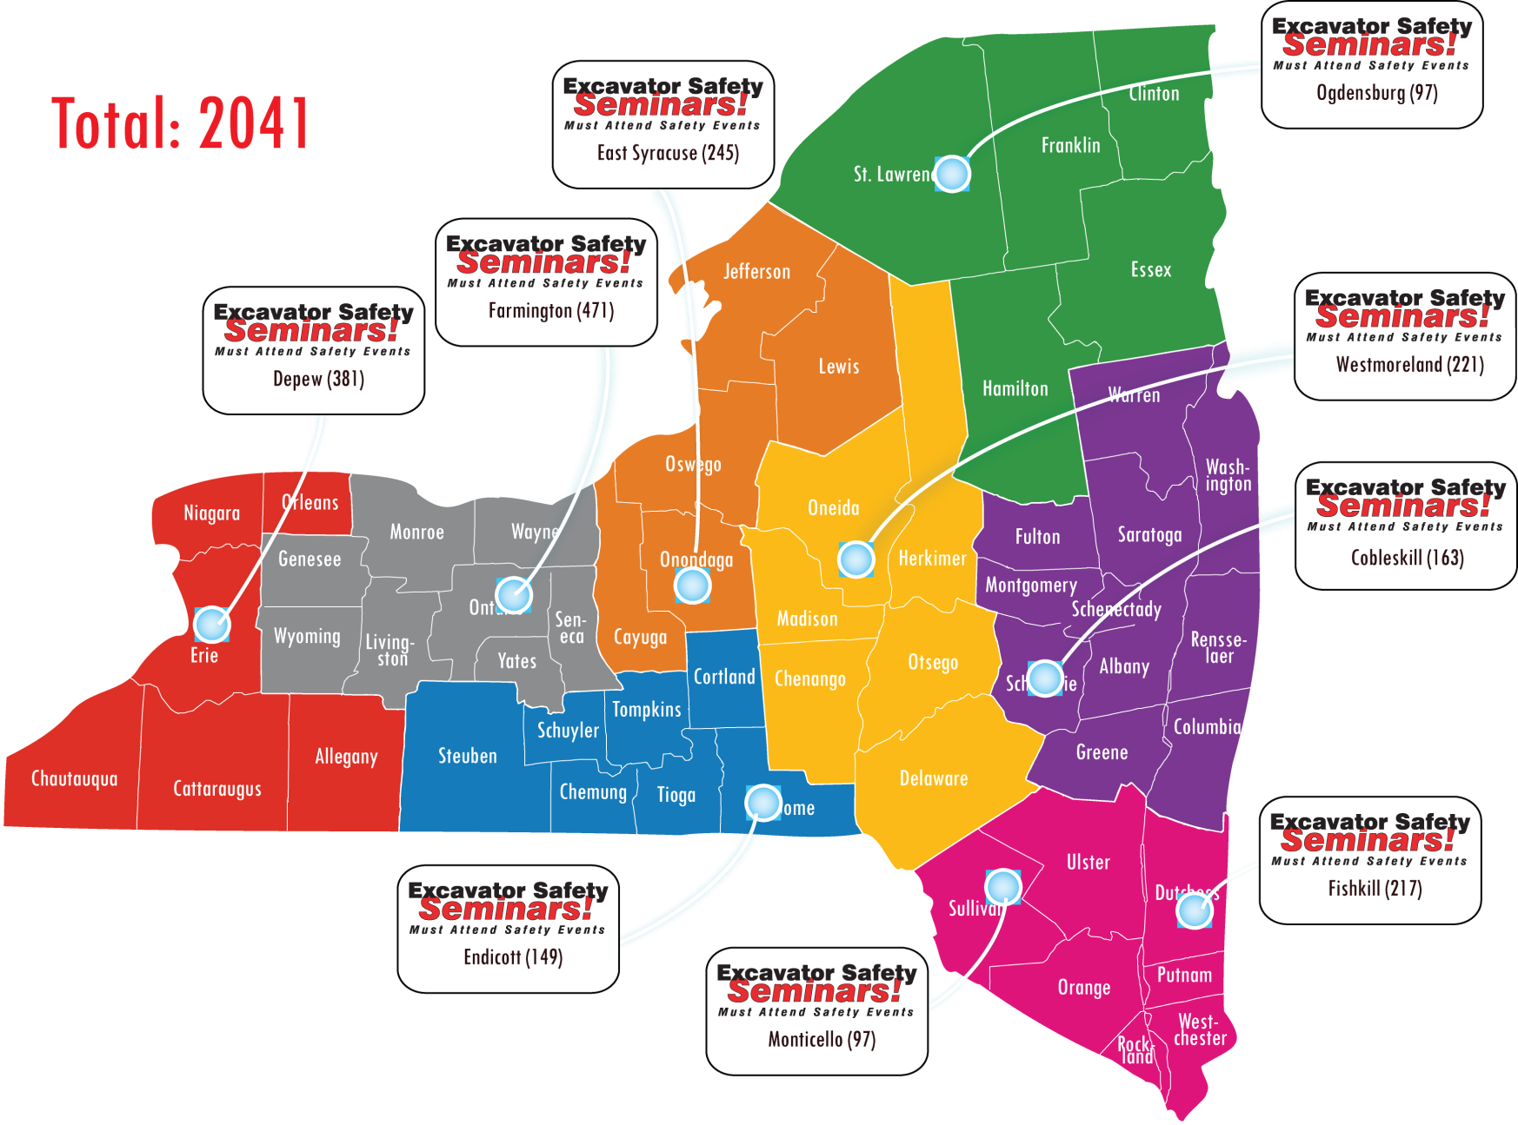
Excavator Seminars
Notes:
In 2010 we held 9 Regional Safety Seminars, totaling 2041 excavators receiving training in the Month of March prior to the kick-off of the NY excavation Season. These events for the most part allow anyone to attend one of the events within an hours drive.

Slide 12
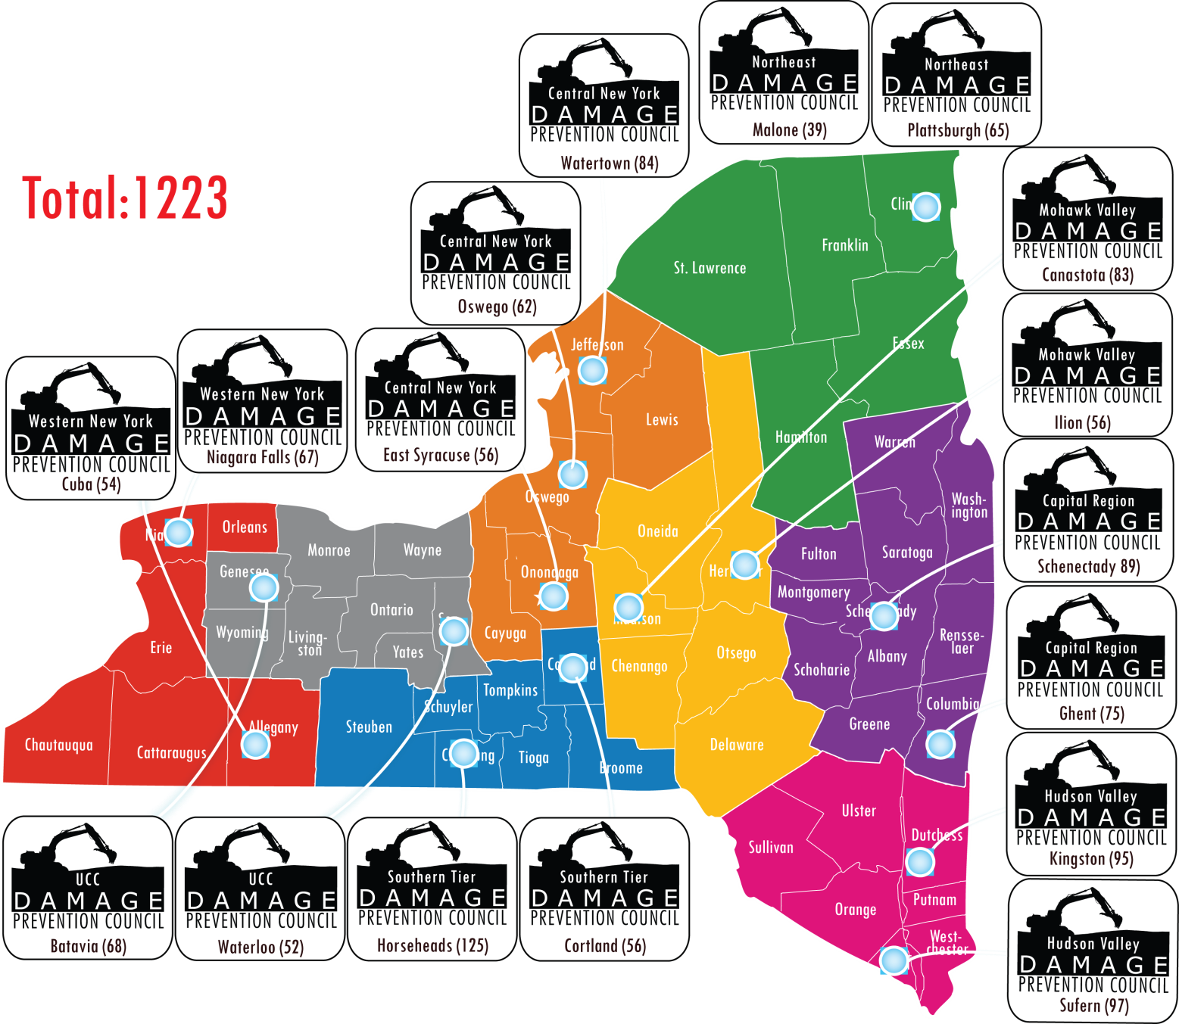
DPC Breakfasts
Notes:
Then we augmented those events with smaller Damage Prevention council supported breakfasts. In total 16 breakfast were held with another 1223 in attendance. These event locations were strategically held in counties that the damage reports indicated needed focus. Understanding that many of you are probably not familiar with NY’s county geography the reports pointed directly to some rural counties like Columbia county. Columbia County does not have high call volumes and with out the damage data it had been relatively ignored with our previous training Strategy.

Slide 13
Notes:
however when looking at the data 2050 calls and 16 damages led us to holding a breakfast there and based on the attendance and feedback from the event we needed to be there.

Slide 14
11,000
Notes:
In addition to these events the field staff targeted specific companies and training events resulting in over 11,000 excavators receiving safe digging/damage prevention training. Up from 2009 (10,000) and 2008 (9363) training totals the first year we started collecting this information with Virtual Private dirt and IrthNet outreach. So Not only are we reaching more people we are reaching more people in the areas that need focus. This approach to damage prevention better supports the needs of our membership as we can be better support their Damage prevention needs when information is shared.

Slide 15
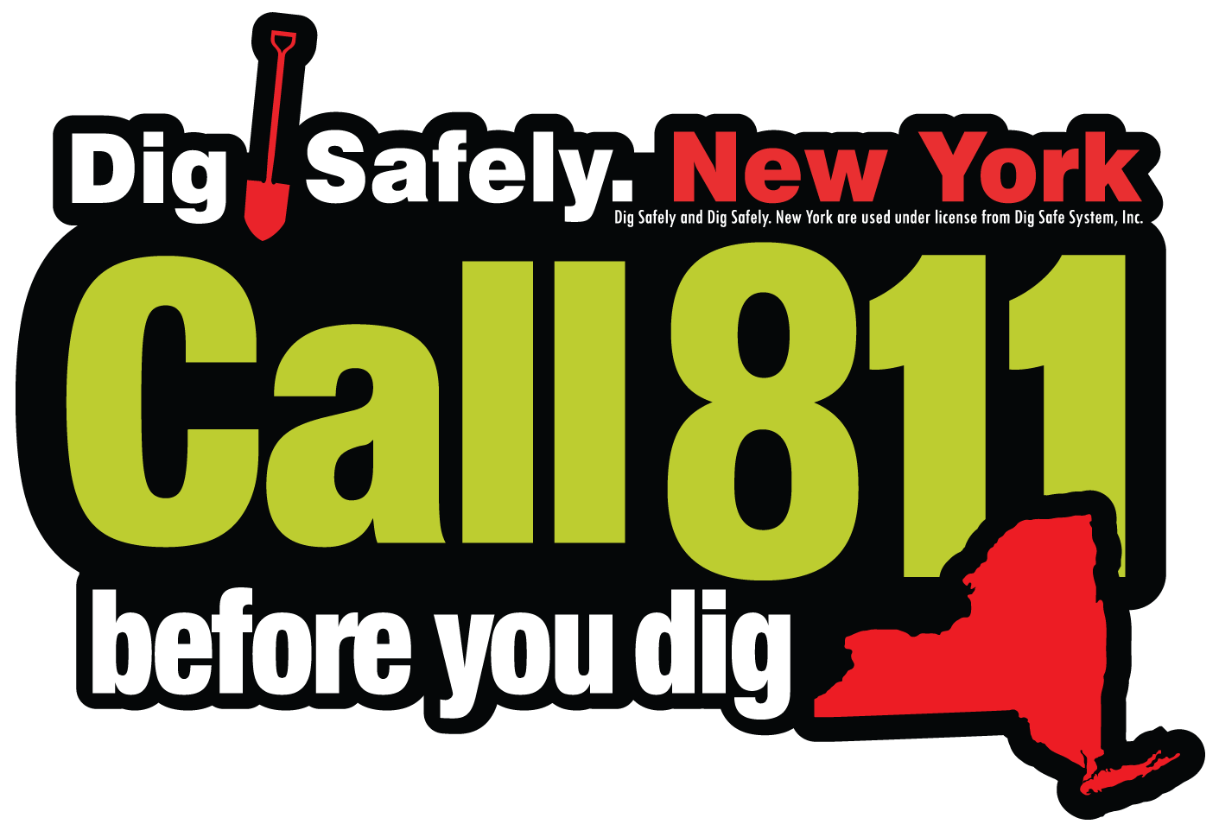

IrthNet OutReach
MEMBERS
Notes:
The Call Center and proper assessment of information
Virtual Private Dirt
IrthNet Awareness

Slide 16
THANK you

